Slide 1
INFORMATION MEETING
Public Notice n. 03/2022 - Capitalization of the results of cooperation projects financed under the INTERREG V A –Italy-Malta Programme - Priority axis I, II, III
04 August 2022, at 9:30 am
on line
Autorità di Gestione - Segretariato Congiunto
Piazza Luigi Sturzo, 36 - 90139 Palermo (IT)
Tel +39 091 7070036 / 254 / 243 / 186 / 059 - Fax +39 091 7070054
stc.italia-malta@regione.sicilia.it
www.italiamalta.eu

Slide 2
Index of topics
Public Notice n. 3/2022
Capitalization
Capitalization mode
Features of the projects
Financial allocations
Beneficiaries
Selection criteria
Eligibility requirements
Qualitative assesment
Eligible expenditure
Real Costs vs Simplified Costs
Categories of expenditure and Methods of reporting
Application Forms and Attachments
Word section
Excel section
Attachments

Slide 3
Public Notice n. 3/2022
CAPITALIZATION
maximize the results of a project
produce further added value over time
KEY FACTORS
transfer of results
reuse by other stakeholders
policy improvement
Notes:
KETS: elettronica, meccatronica, micro e nanosistemi, biotecnologia e ricerca applicata alla salute dell’uomo

Slide 4
Public Notice n. 3/2022
CAPITALIZATION METHODS
ready-to-use
additional results compared to those already achieved
reuse/enhancement of results for which the original project used resources
scaling up
greater impact by extending or replicating the experience
identification of the "transfer potential" means transposition conditions based on methodologies or plans
mainstreaming & embedding
integration of results into policies and programmes
connection between beneficiaries and takers (re-users) of the results, also involving policy takers
Notes:
KETS: elettronica, meccatronica, micro e nanosistemi, biotecnologia e ricerca applicata alla salute dell’uomo

Slide 5
Public Notice n. 3/2022
Features of capitalization projects
The capitalization character of the proposed actions (transfer and reuse) and the impact in the medium-long term
The cross-border dimension and character of the capitalized actions;
The contribution to the achievement of the objectives and results of the Programme;
The achievement of concrete and lasting results, additional to the original project;
The coherence of the partnership, the relevance and competences of the partners in relation to the objectives of the project;
The relevance of the financial plan and the coherence of the budget with the capitalization objectives;
A financial allocation (ERDF+CN) between a minimum of € 150,000 and a maximum of € 1,000,000;
Maximum duration of 9 months.
Notes:
KETS: elettronica, meccatronica, micro e nanosistemi, biotecnologia e ricerca applicata alla salute dell’uomo

Slide 6
Public Notice n. 3/2022
Financial allocations
Available ERDF resources
€ 2.911.192
Priority Axis I: Euro 801,961 (ERDF share) of which:
for Investment Priority 1.b - Specific Objective 1.1
Priority Axis II: Euro 340,529 (ERDF share) of which:
for Investment Priority 3.a - Specific Objective 2.1
for Investment Priority 8.e - Specific Objective 2.2
Priority Axis III: Euro 1,768,702 (ERDF share) of which:
for Investment Priority 6.d - Specific Objective 3.1
for Investment Priority 5.b - Specific Objective 3.2

Slide 7
Public Notice n. 3/2022
Beneficiaries
ALL or PART of the beneficiaries who make up the partnerships of the projects already financed by the INTERREG V-A Italia-Malta Programme and who intend to activate an operation for capitalization actions.
IN ADDITION
The existing partnership may establish the entry of new beneficiaries provided that it is demonstrated:
the consistency of the new potential beneficiary with respect to the proposed capitalisation actions
the operation of the new potential beneficiary
the spending capacity within the project

Slide 8
Public Notice n. 3/2022
Beneficiaries - Legal status
Public Body
The State, the regional or local authorities referred to in the definition of Art. 2.1 of Directive 2014/24/EU of the European Parliament and of the Council of 26/02/2014
Private entity
Bodies, including non-profit-making bodies, provided that they have legal personality
Organisms that have all the following characteristics, referred to in Art. 2.4 of Directive 2014/24/EU :
a)they are established for the specific purpose of meeting needs in the general interest, not having an industrial or commercial character;
(b) they have legal personality; and
(c)they are financed, for the most part, by the State, regional or local authorities, or by other bodies governed by public law; or are subject to management supervision by those authorities or bodies; or have an administrative, managerial or supervisory board, more than half of whose members are appointed by the State, regional or local authorities, or by other bodies governed by public law;
Bodies governed by public law

Slide 9
Selection criteria
Selection criteria
Formal eligibility requirements
Quality assessment of the project proposals
ON/OFF
Max 200
20 Appropriateness of capitalisation
The minimum score refers to:
20 Effectiveness of capitalization
20 Cross-border size and character of capitalisation actions
Notes:
closely linked to effect on trade
small distortion enough
magnitude of distortion may impact on compatibility assessment (the more distortive, the less likely that measure is compatible)

Slide 10
Criteri di selezione
Criteri di selezione
Requisiti di ammissibilità formale
Administrative Compliance |  | YES | NO
1 | The project proposal has been completed in the standard template "Application Form" |  |  | Comments
2 | The Application Form has been drawn up in one of the two official languages of the program (Italian and English) and a summary has been provided in the other language
3 | The Application Form includes all of the following annexes: - letter of intent and co-financing lead partner/partner, - copy of the front and back of an identity document of the lead partner and each partner, - formal administrative act of approval of the project proposal by the lead partner, - any permits or authorizations, where relevant - statute of the institution (certified copy), for private entities and bodies governed by public law only - last two approved balance sheets, for private entities and bodies governed by public law only - State aid declaration and its sub-annexes
4 | The Application Form and the annexes have been sent within the time limits set by the public notice
5 | The Application Form and its attachments contain all the necessary signatures and stamps of the Lead partner/partner
6 | The project activities are pursued by the proposer in compliance with the provisions contained in Article 6- Eligible actions for each mode of capitalization of the Public Notice (mode 1, mode 2, mode 3)
Partnership |  | YES | NO
7 | The Lead Partner and the partners have their main and/or operational headquarters, including administrative competence, in the eligible territory (Art. 7 – Types of eligible beneficiaries and State aid)
8 | The lead partner er and the partners have a legal status as required by the Public Notice (Art. 7 – Types of eligible beneficiaries and State aid)
Financial aspects |  | YES | NO
9 | The project budget is in line with all the requirements of Art. 10 of the Public Notice and has a financial budget (ERDF + CN) between a minimum of € 150,000 and a maximum of € 1,000,000

Slide 11
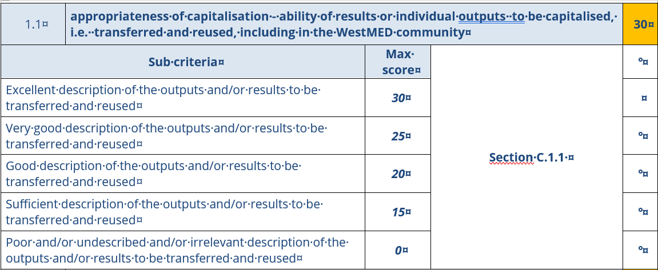
Opzione costi semplificati
Criteri di selezione vs Application Form
Criteri di selezione
Application Form
C.1.1 Quali sono le azioni di capitalizzazione che si intende realizzare in linea con una delle tre modalità proposte dall’Avviso Pubblico (art. 6). Descrivere con chiarezza: 1) quali sono gli output/ risultati rilevanti che sono stati raggiunti a conclusione del progetto finanziato nell’ambito del programma INTERREG V-A Italia-Malta; 2) perché tali output/risultati ottenuti a conclusione del progetto finanziato nell’ambito del programma INTERREG V-A Italia-Malta sono ritenuti strategici e possono essere capitalizzati, ovvero trasferiti e riutilizzati, anche all’interno della “community” WestMED; 3) perché la modalità di capitalizzazione selezionata è ritenuta la più idonea. C.1.1 Which are the capitalization activities that are intended to be carried out in line with one of the three mode proposed by the Public Notice (art. 6) Please, clearly describe: 1) which are the relevant outputs / results achieved after the conclusion of the project financed under the INTERREG V-A Italy-Malta programme; 2) why are these outputs / results achieved after the conclusion of the project financed under the INTERREG V-A Italy-Malta programme considered strategic and can be capitalized, or transferred and reused, even within the WestMED "community"; 3) why is the selected capitalization mode considered the most suitable.
Max 3000 caratteri – Max 3000 characters

Slide 12
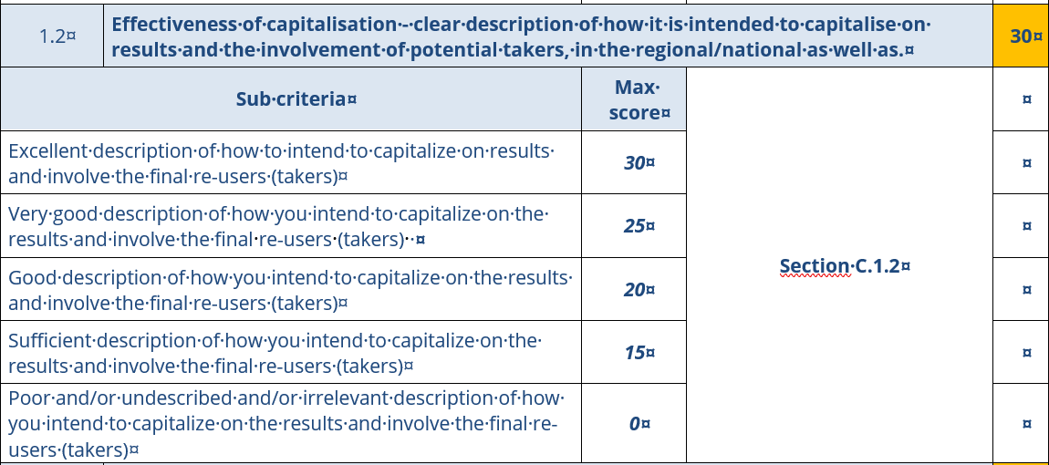
Opzione costi semplificati
Criteri di selezione vs Application Form
Criteri di selezione
Application Form
C.1.2 Efficacia della capitalizzazione Descrivere con chiarezza come si intendono capitalizzare i risultati e attraverso quali azioni chi sono i potenziali ri-utilizzatori (takers) italiani e maltesi come saranno coinvolti i potenziali ri-utilizzatori (takers) italiani e maltesi C.1.2 Effectiveness of capitalisation Please, clearly describe: 1) how the results are intended to be capitalized and through which actions 2) who are the potential Italian and Maltese re-users (takers) 3) how potential Italian and Maltese re-users (takers) will be involved
Max 3000 caratteri Max 3000 characters

Slide 13
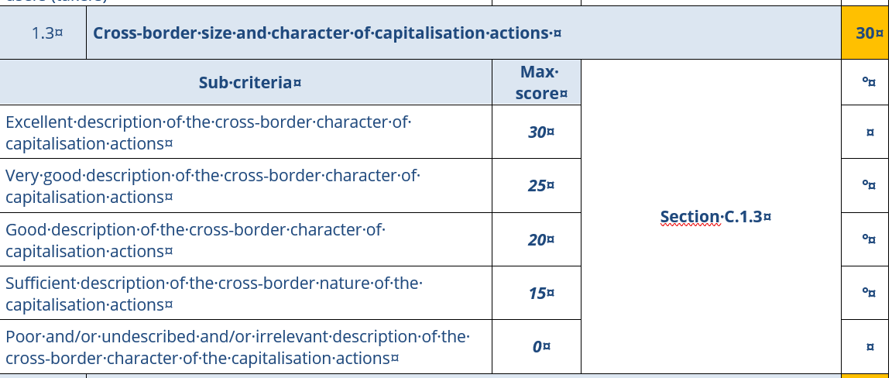
Opzione costi semplificati
Criteri di selezione vs Application Form
Criteri di selezione
Application Form
C.1.3 Dimensione e carattere transfrontaliero delle azioni di capitalizzazione Descrivere chiaramente quali impatti produrranno le azioni di capitalizzazione (trasferimento e riuso) a livello transfrontaliero in termini di beneficio per i territori coinvolti dal programma C.1.3 Cross-border size and character of capitalisation actions Clearly describe which impacts will be generated by the cross-border capitalization actions (transfer and reuse) will in terms of benefit for the territories involved in the program
Max 3000 caratteri Max 3000 characters

Slide 14
Selection criteria
Selection criteria
STRATEGIC EVALUATION CRITERIA | 200
20 points minimum for each
IAppropriateness of capitalisation | 30
Effectiveness of capitalization | 30
Cross-border size and character of capitalisation actiones | 30
Contribution of the project to the achievement of the objectives and results of the program | 30
Sustainability of project outputs/outputs and results | 15
Consistency of relevant and competent actors to pursue the objectives and results of the project | 15
Proportionality of the budget to the expected results | 25
Reliability of the schedule | 25

Slide 15
Selection criteria
Selection criteria
STRATEGIC EVALUATION CRITERIA | 200
20 points minimum for each
Appropriateness of capitalisation | 30
Effectiveness of capitalization | 30
Cross-border size and character of capitalisation actiones | 30
Contribution of the project to the achievement of the objectives and results of the program 30
Sustainability of project outputs/outputs and results | 15
Consistency of relevant and competent actors to pursue the objectives and results of the project | 15
Proportionality of the budget to the expected results | 25
Reliability of the schedule | 25

Slide 16
Opzione costi semplificati
Categorie di Spesa e Modalità di Rendicontazione
Real Costs vs Simplified Costs
REAL COST
Reporting through the presentation of all supporting documents of expenditure and payment, up to the amount declared
APPLICATION
SIMPLIFIED COST
Reporting without the presentation of individual supporting documents of expenditure and payment

Slide 17
Opzione costi semplificati
Categories of Expenditure and Methods of Reporting
Simplified costs
It is no longer prescribed to trace each euro of co-financed expenditure in order to trace the individual supporting documents
Key point
Significant reduction in administrative burdens for the beneficiary
Advantage
Flat rate
Calculation method

Slide 18
CCategories of Expenditure and Methods of Reporting
Categories of expenditure
Reporting methods
  Staff costs
  on a flat-rate basis equal to 15% of the direct costs other than the staff costs of this operation
  Office and administrative expenditure
  on a flat-rate basis equal to 10% of staff costs
  Travel and accommodation costs
  Based on actual costs documented for the purposes of the project and whose total amount may not exceed the maximum percentage of 2% of the total cost of the project.
  External expertise and services costs
  Based on actual costs documented for the purposes of the project and for the first level controls
  Equipment expenditure
  Based on real costs documented for the purposes of the project.

Slide 19
Categorie di spesa
Categories of Expenditure and Methods of Reporting
Categories of expenditure – Staff costs
remuneration expenses, related to activities that the entity would not carry out if the operation in question were not carried out, laid down in an employment/job contract
WHAT
any other costs directly related to the payment of wages incurred by the employer and not recoverable (e.g. contribution taxes, etc.)
Full Time
HOW
Part-time
1 h labor = Gross annual labor cost/1720

Slide 20
Categorie di spesa
Categories of Expenditure and Methods of Reporting
Categories of expenditure – Office and Administrative Expenditure
office rent;
insurance and taxes concerning the building hosting the staff and office’s equipment (ex: theft and fire insurance);
consumption for utilities (e.g. electricity, heating, water);
office supplies;
general accounts within the beneficiary organisation;
archives;
maintenance, cleaning and repairs;
security;
information systems;
communication (e.g. telephone, fax, Internet, postal services, business cards);
bank expenses for the opening and management of a bank account or more if the operation requires a separate account;
charges linked to financial and transnational transactions

Slide 21
Categorie di spesa
Categories of Expenditure and Methods of Reporting
Categories of expenditure – Travel and subsistence expenses
a) travel expenses (for example, tickets, travel insurance and car insurance, fuel, mileage car reimbursement, tolls and parking fees);
(b) food costs;
(c) subsistence expenses;
(d) visa fees;
(e) daily allowances.
Eligible expenditure if provided for in internal regulations/circulars
ATTENTION
In the absence of regulations, those of the Sicilian Region apply
Expert travel expenses are part of the consultancy costs

Slide 22
Categorie di spesa
Categories of Expenditure and Methods of Reporting
Categories of expenditure – Consultancy and external services
studies or surveys
training;
translations;
computer systems and creation, modifications and updates of websites;
promotion, communication, publicity or information activities related to an operation;
financial management;
services related to the organization and implementation of events or meetings (location, interpretation);
participation in events (for example, registration fees);
legal advice services and notarial services, technical and financial advice, etc.;
intellectual property rights;
verifications referred to in point (a) of Article 125(4) of Regulation (EU) No 1303/2013
guarantees provided by a bank or other financial institution,
travel and subsistence expenses of experts, speakers, meeting chairs and consultants
other advice and specific services necessary for operations

Slide 23
Categorie di spesa
Categories of Expenditure and Methods of Reporting
Categories of expenditure – Expenditure on equipment
a) Office equipment;
b) Hardwares and softwares;
c) Furnitures and accessories;
d) Lab equipment;
e) Tools and machines;
f) Devices;
g) Vehicles;
h) Other specific devices necessary for the operation.
They have not benefited from any other assistance from the ESI Funds
SECOND HAND
The price is not higher than the generally accepted costs on the market
Necessary for operation and compliance with applicable standards

Slide 24
Application Form – Word Section
Application Forms and Attachments
Application Form – Excel Section
Annex A – Letter of intent and co-financing
Annex B – Co-financing letter by the co-financing entity
Annex C – State aid declaration

Slide 25
Focus – Annex C (State Aid Declaration)
Application Forms and Attachments
Obligation to submit a State Aid Declaration
ANNEX C
Private entity
If the activities are NOT relevant for State aid purposes
Whether the activities are relevant for State aid purposes
Bodies governed by public law
Obligation to submit only the Annex C
Obligation to complete Annex C
+ Annex C – Sec. C1
The only possible choice:
- DE MINIMIS option
Public Body

Slide 26
THANK YOU FOR YOUR ATTENTION
MANAGING AUTHORITY
Federico Lasco
dipartimento.programmazione@regione.sicilia.it
Daniela Bica
d.bica@regione.sicilia.it
area7programmazione@regione.sicilia.it
MALTESE CO-ORDINATION AUTHORITY
Anthony Camilleri
anthony.c.camilleri@gov.mt
Abigail Camilleri
abigail.b.camilleri@gov.mt
Maria Elena Muscat
maria-elena.muscat@gov.mt
JOINT SECRETARIAT
Marco Sambataro
Ilva Parlato
Chiara Di Bella
Antonella Madonia
stc.italia-malta@regione.sicilia.it

